Slide 1
Cinematic Compass
——A Multi-Dimensional Movie Recommendation System
Group 2

Slide 2
1
Project Overview & Team Collaboration
2
Data and Four Analytical Modules
CONTENTS
3
Integration and Personalized Recommendation
4
Visualization & Final Deliverables
5
Conclusion & Future Work

Slide 3
Project Overview & Team Collaboration
Section 1

Slide 4

Project Motivation & Goals
WORK SUMMARY REVIEW
Why a Movie Recommendation System? To address information overload, diverse user preferences, and the growing need for interpretable recommendations.
Project Objective: Build a multi-dimensional recommendation system integrating content, ratings, business, and temporal perspectives to deliver personalized movie suggestions.
Overall Workflow: Data Collection → Four Analytical Modules → Unified Normalization & Merging → Personalized Recommendation → Interactive Visualization.
WORK SUMMARY REVIEW

Slide 5
Team Structure & Collaboration
Modular Responsibilities
01
02
03
04
许双博
王韵嘉
武红玮
李尚泽
1.Content Analysis
– extracting features from movie metadata and genres.
2. Score Integration & Visualization webpage
1.Rating Behavior
– modeling user preference patterns through statistical analysis.
2.Making PPT part 1
1.Business Insights
– aligning recommendation outputs with real-world market value.
2.Making PPT part 5
1.Temporal Dynamics
– capturing time-based shifts in viewing trends. 2.Making PPT part 3,4

Slide 6
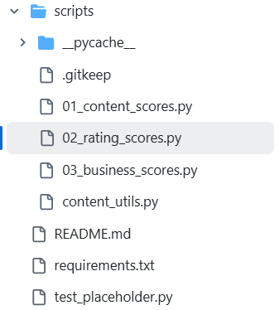
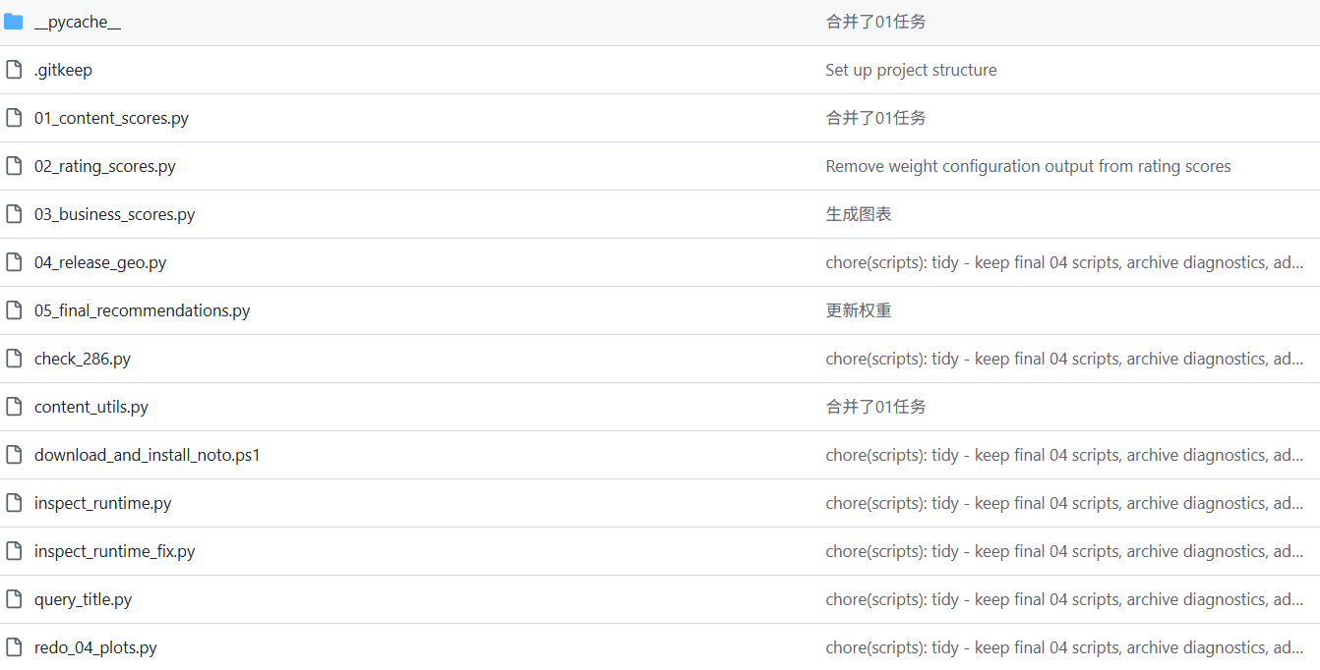
Collaboration via GitHub
WORK SUMMARY REVIEW
Branch Naming Convention
01
e.g., stage1/01_content for structured progress tracking.
Pull Requests
02
Used for peer review and controlled merging. All merges undergo peer review to ensure stability.
Commit Logs
03
Structured naming with stage identifiers for clear progress tracking. Each commit includes stage identifiers (e.g., stage2_refactor_rating) for transparency and reproducibility.

Slide 7



Tools & Workflow
WORK SUMMARY REVIEW
Development Platform
Communication
Documentation
GitHub + Jupyter Notebook for experimentation and integration.
Teams / WeChat for real-time discussion and decision-making.
Standardized logs stored under reports/logs/, ensuring experiment reproducibility and auditability across stages.

Slide 8

02. Ratings & Popularity
WORK COMPLETION
Highlights
Objective
Balanced focus on quality (ratings) and reach (popularity).
Enhanced fairness for less mainstream yet highly rated titles.
Structured outputs for seamless integration into the overall recommendation pipeline.
80%
To quantify movie quality and audience engagement using rating-related metrics and balance their influence in the overall recommendation system.
Data Fields
vote_average – the mean audience rating of each movie.
vote_count – the number of users who rated the movie (indicating popularity reliability).
popularity – a platform-based popularity index combining views, votes, and interactions.
60%

Slide 9
Data and Four Analytical Modules
Section 2

Slide 10
2-1 Content
genres、keywords、overview、title
By 许双博

Slide 11
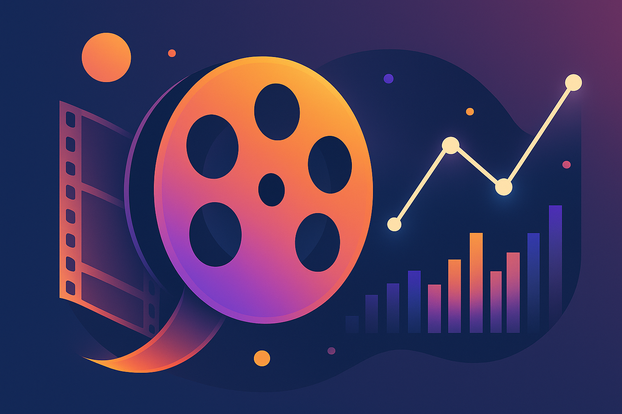
Module 01: Content Analysis
Fields analysed: genres, keywords, overview & title
Genres List of movie categories
Keywords Descriptive tags
Overview Plot summary
Title Movie name
[1]
Notes:
Here we focus on content analysis, which captures both categorical and narrative information of each movie. We analyse four key fields — genres, keywords, overview, and title. Genres and keywords describe what the movie is about, while the overview and title provide its storyline and theme. Together, they form the textual foundation for our later similarity and scoring analysis.
这一页展示的是“内容分析”模块，我们提取了每部电影的分类与叙事信息。 分析的四个主要字段是类型、关键词、剧情简介和标题。 类型和关键词说明电影的主题，简介和标题反映其故事与风格。 这些文本特征共同构成后续相似度计算与内容评分的基础。

Slide 12
Methodology & Scoring
1. Feature extraction • Parse genres & keywords JSON into lists • Build a corpus from title and overview • Compute TF‑IDF norm; count keywords/genres; measure lengths 2. Transformation • Apply log(1+x) compression to dampen long tails • Use Min‑Max scaling to map features into [0,1] 3. Weighted scoring • Combine scaled features using preset weights • Multiply by 100 to obtain the final content score
[2] [3]
Notes:
This slide explains how we calculated the content score. First, we extracted features by parsing genres and keywords from JSON, combining them with the title and overview to capture lexical richness. We also measured the number of keywords, genres, and the length of the text fields. Next, we applied a logarithmic transformation to reduce the effect of extremely long descriptions, and used Min–Max scaling to normalize all features between zero and one. Finally, we combined these scaled features with preset weights — as shown in the chart, TF-IDF contributes about thirty-five percent — to produce a final content score ranging from zero to one hundred.
这一页展示我们如何计算内容得分。 首先，我们从 JSON 中解析类型和关键词，并结合标题与剧情简介，提取文本特征。 同时统计关键词数、类型数以及文本长度，以衡量语言丰富度。 然后，我们用对数变换削弱极端长文本的影响，并用最小–最大归一化将各项指标映射到 0 到 1。 最后，按预设权重加权合成得分，其中 TF-IDF 约占 35%，得到 0 到 100 范围的最终内容评分。

Slide 13
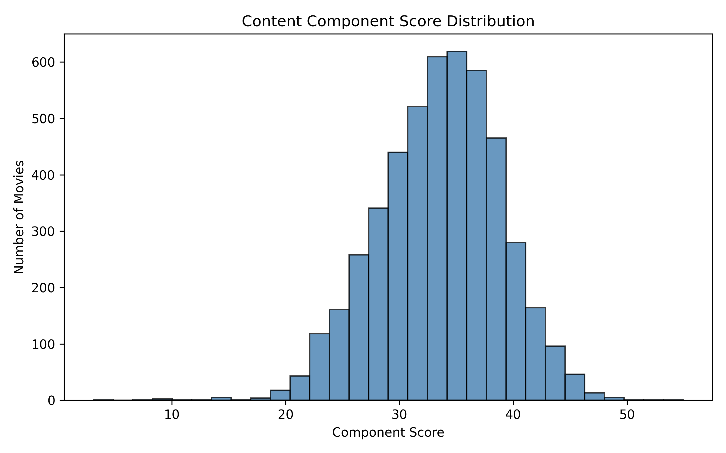
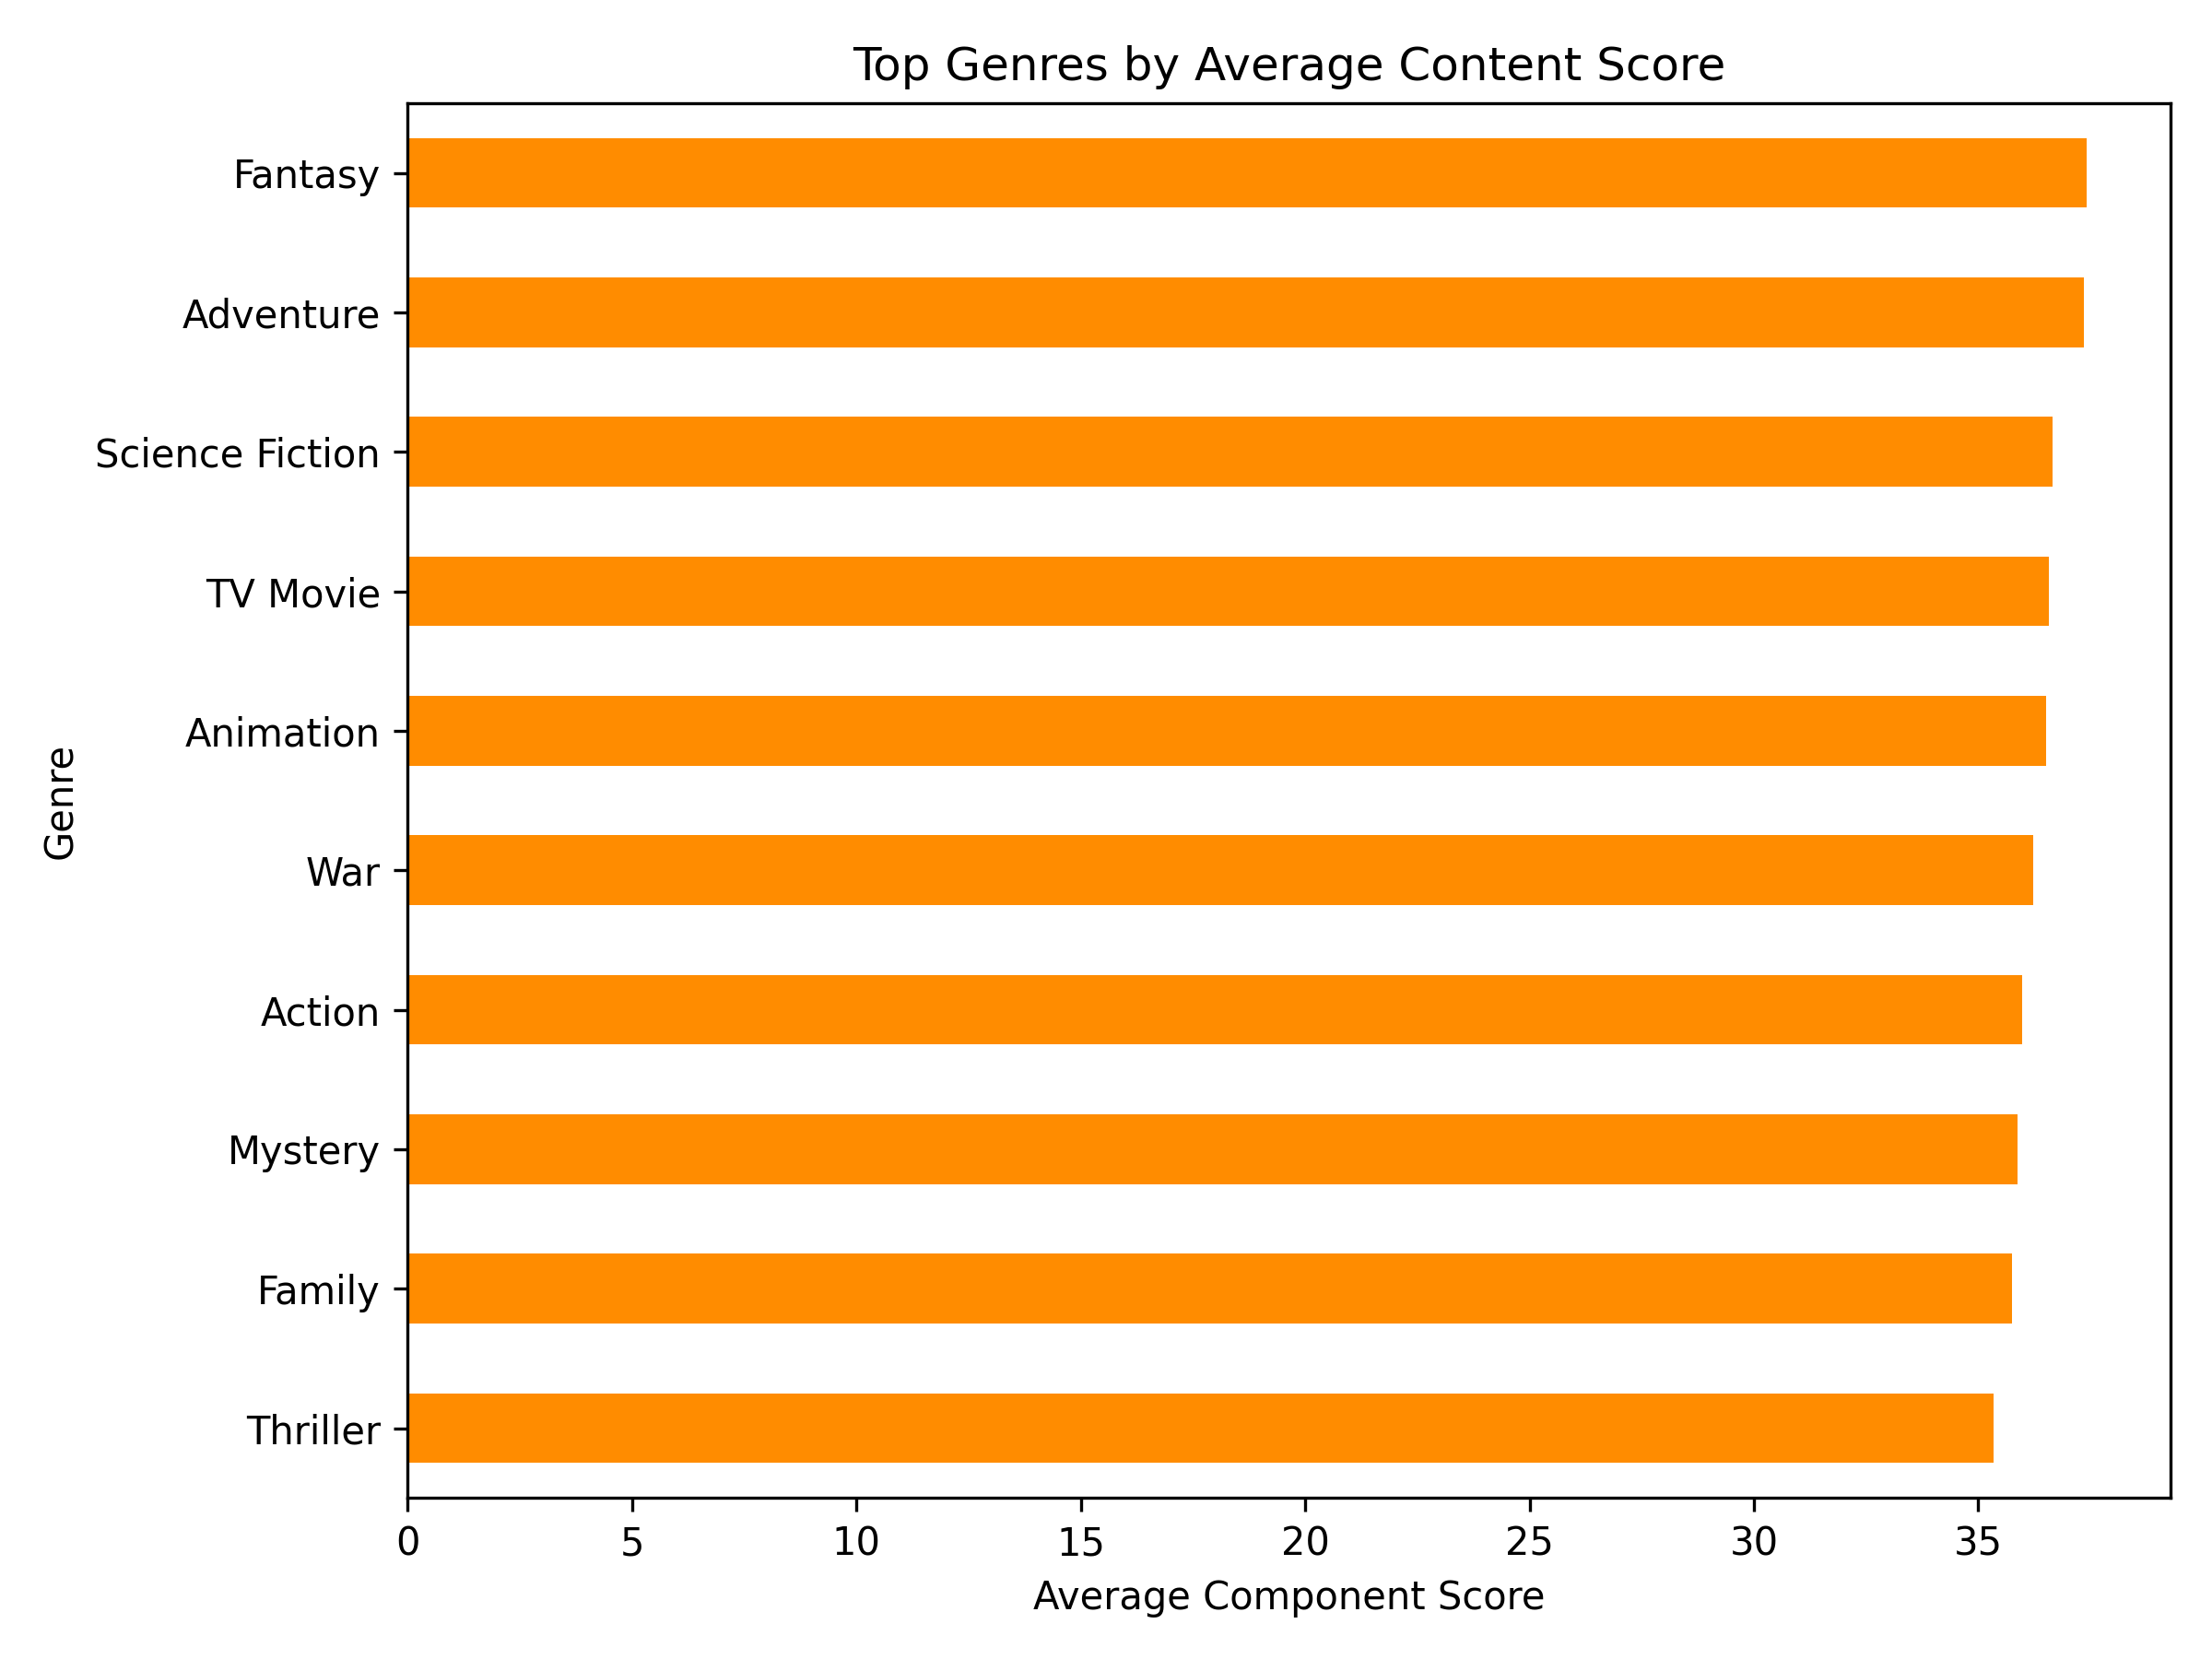
Results & Insights
Content Score Distribution
Top Genres by Average Score
• Mean score: 33.55 • Median: 33.87 • Range: 3.13–54.90
Rank | Title | Score
1 | Crossroads | 54.90
2 | Southland Tales | 52.74
3 | In the Heart of the Sea | 50.07
[2] [3] [4]
Notes:
On the left, we can see that most movies have content scores clustered around the low thirties, with a mean of thirty-three point five and a median of thirty-three point nine. Genres like Fantasy, Adventure, and Science Fiction rank the highest, showing rich storytelling and imaginative content. At the bottom, the top films — Crossroads, Southland Tales, and In the Heart of the Sea — stand out for their detailed overviews and diverse keyword sets.
左图显示，大多数电影的内容得分集中在三十出头，平均值为 33.5，中位数为 33.9。 幻想、冒险和科幻类电影得分最高，体现了更丰富的叙事与想象力。 下方三部高分影片《十字路口》《南国故事》和《海洋深处》，因剧情简介细致、关键词多样而脱颖而出。

Slide 14
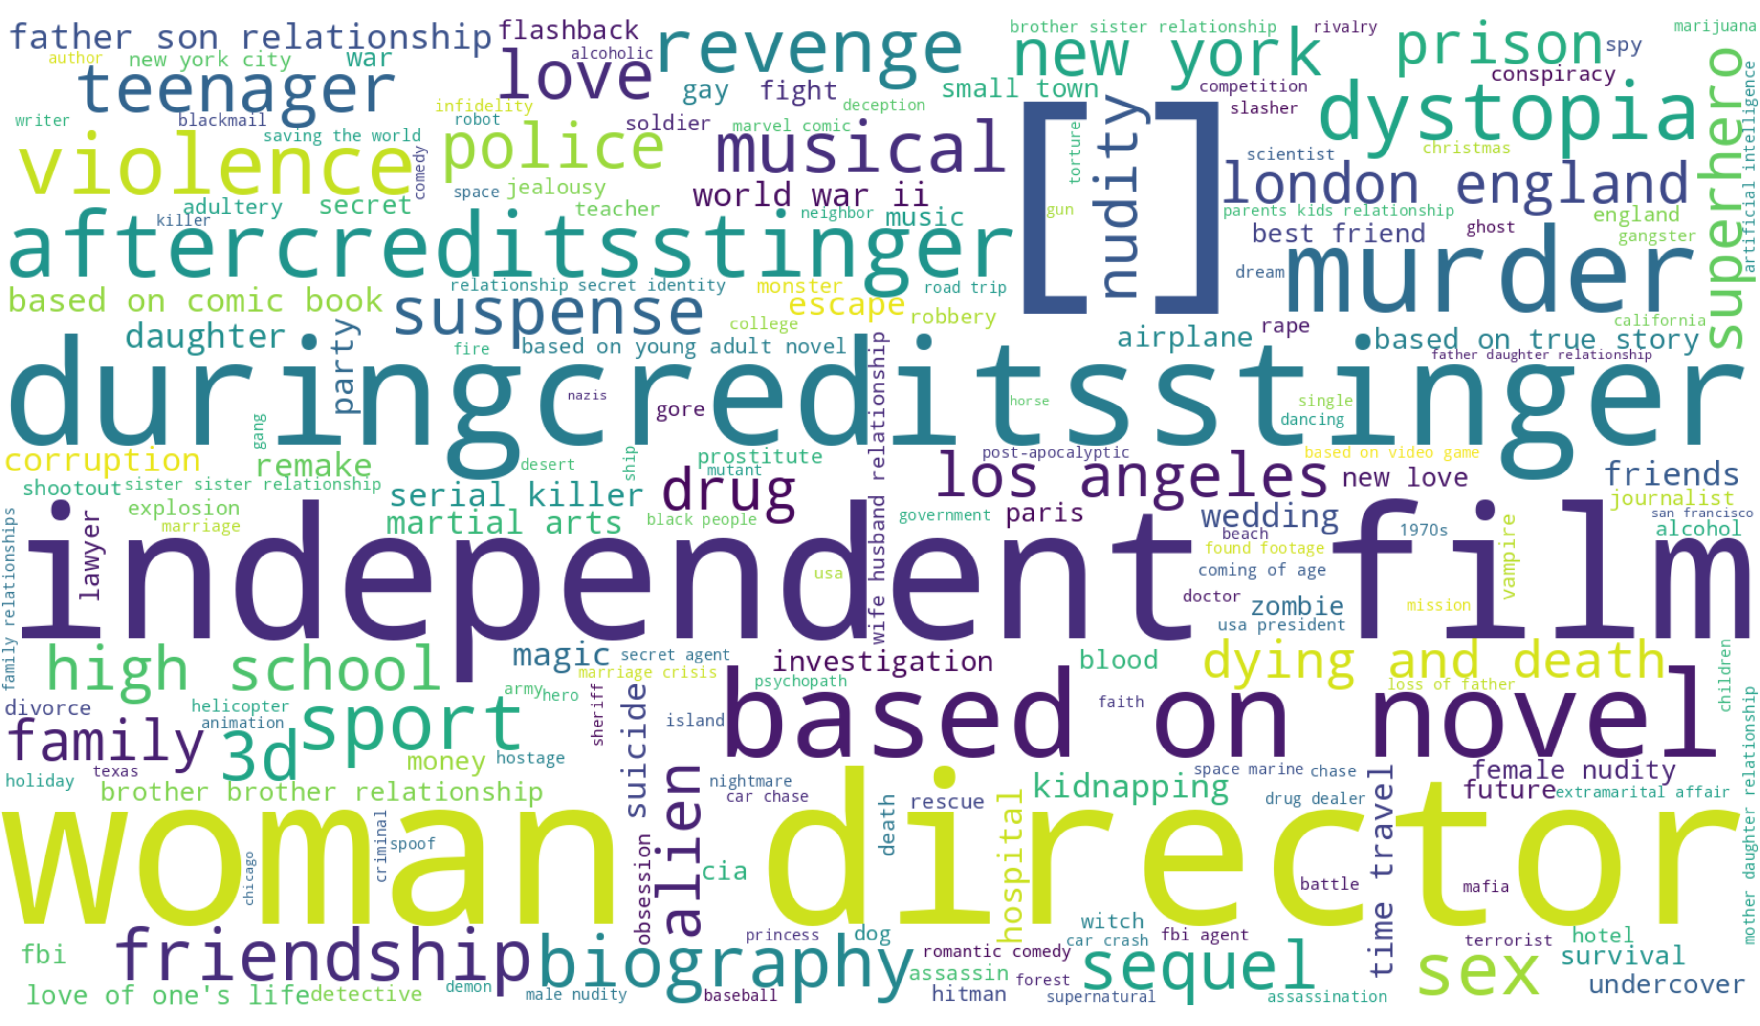
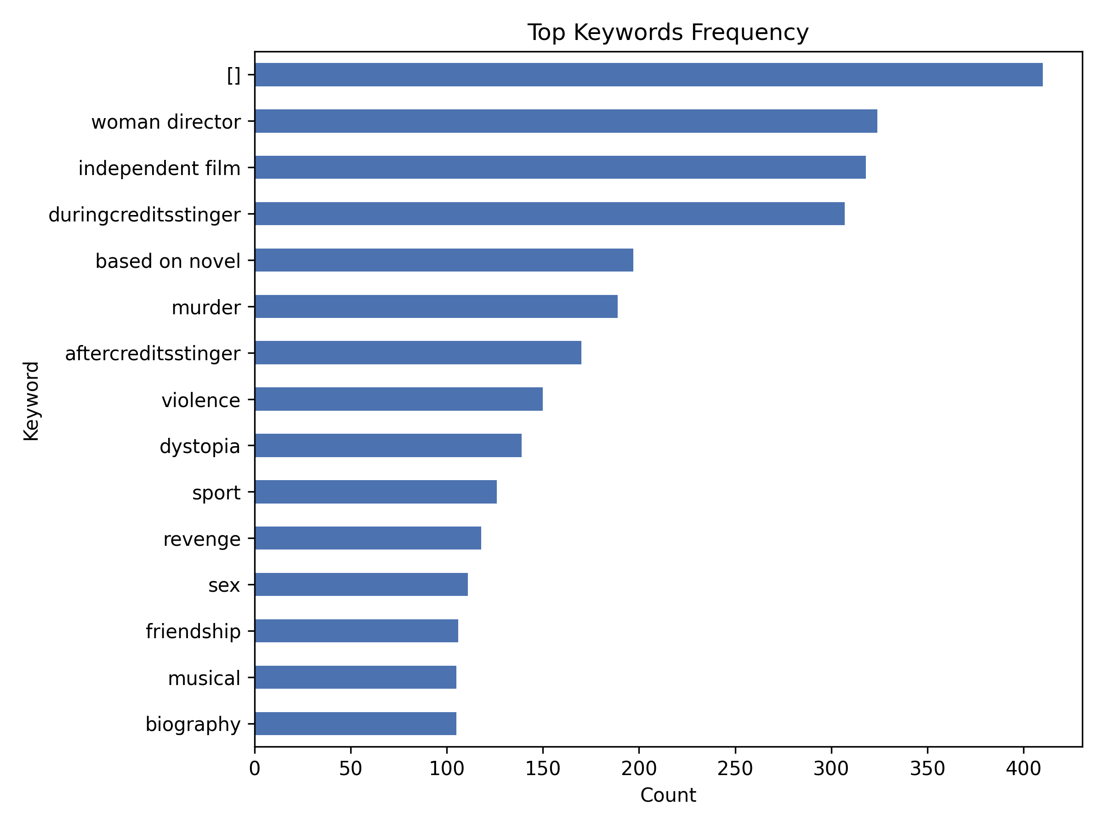
Results & Insights
keyword wordcloud
01 keyword frequency
Notes:
Here we visualized the most frequent keywords. The word cloud on the left highlights terms like independent film and after-credits stinger, showing common creative themes. The bar chart on the right confirms their high frequency across the dataset.
这一页展示最常出现的关键词。 左侧词云突出“独立电影”、“片尾彩蛋”等常见主题， 右侧柱状图验证了这些关键词在数据集中出现频率最高。

Slide 15
2-2 Ratings & Popularity
vote_average、vote_count、popularity
By 王韵嘉

Slide 16
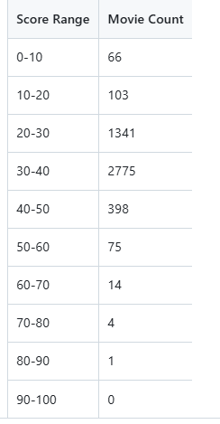
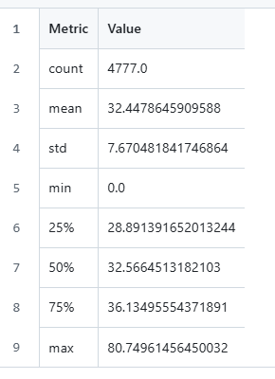
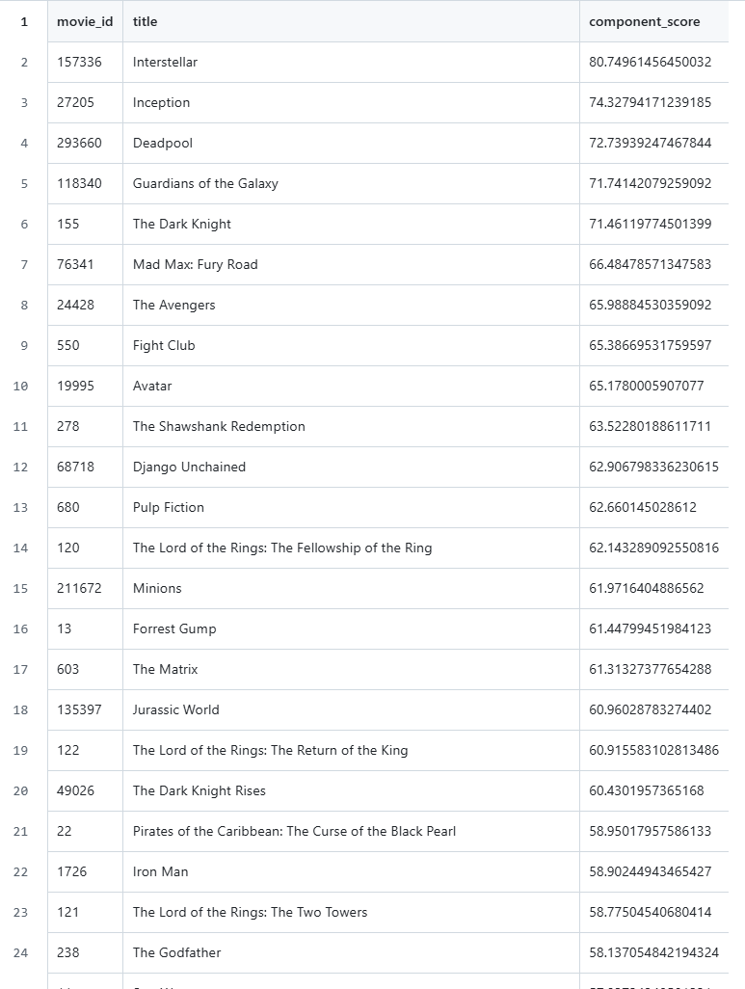
Methodology
WORK COMPLETION
1. Standardized Rating Distribution:
All rating-related variables were normalized to ensure comparability across scales and to avoid bias from extreme values.
2. Weighted Popularity Adjustment:
To avoid overemphasizing either quality or quantity, a balanced weighting strategy was applied:
Final Score=𝑓(vote_average,vote_count,popularity)
where rating quality and popularity were proportionally balanced using z-score normalization and scaling factors.
3. Output Files:
02_rating_scores.csv — consolidated rating and popularity scores for each movie.
02_rating_distribution_table.csv — statistical summary of rating dispersion.
02_rating_summary_states.csv — mean, median, and variance indicators for validation.

Slide 17
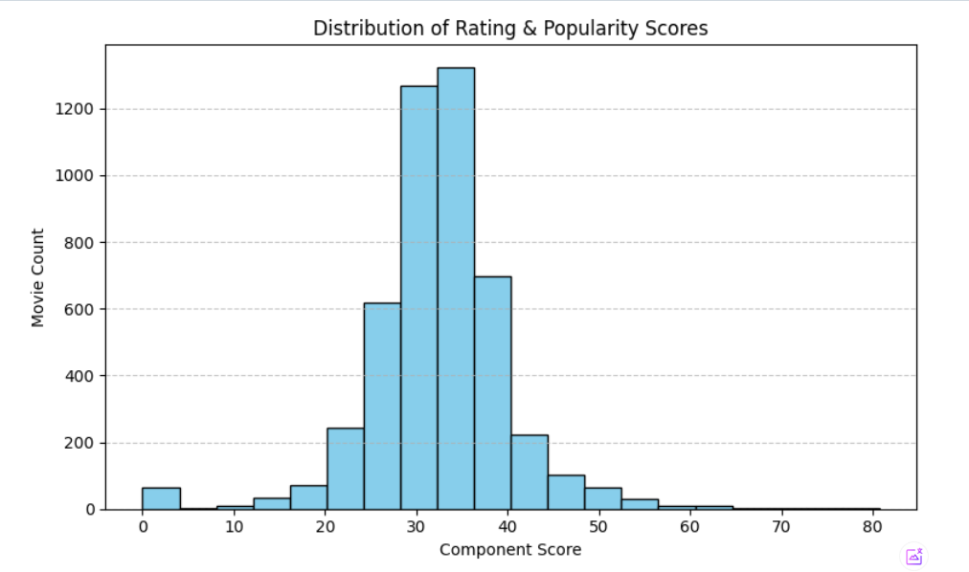
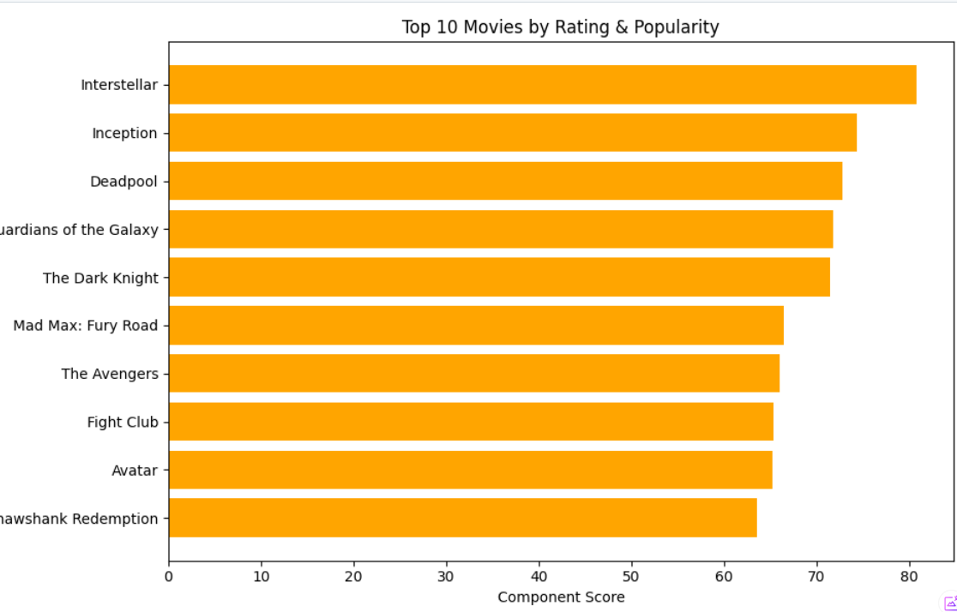
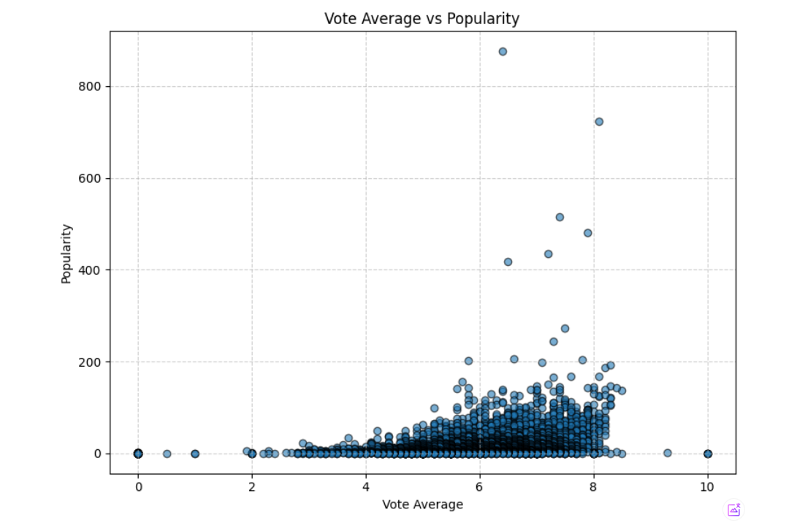
Visualization & Key Insights
WORK SUMMARY REVIEW
Distribution Analysis
Top 10 Rated Movies
Scatter Plot
illustrates the standardized rating curve, confirming a mild right-skew typical of user rating systems.
showing the highest combined rating-popularity scores.
visualizes the relationship between vote_average and popularity, revealing clusters of niche versus mainstream hits.

Slide 18
2-3 Business
budget、revenue、production_companies
By 武红玮

Slide 19
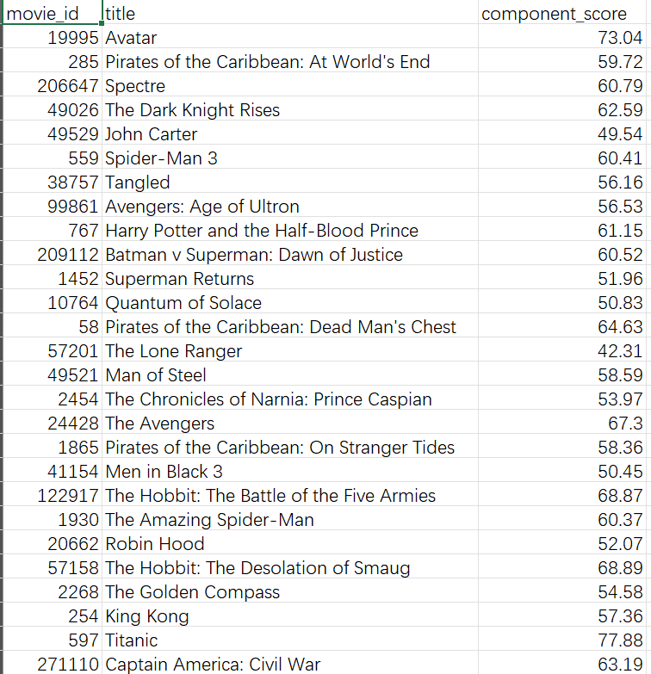
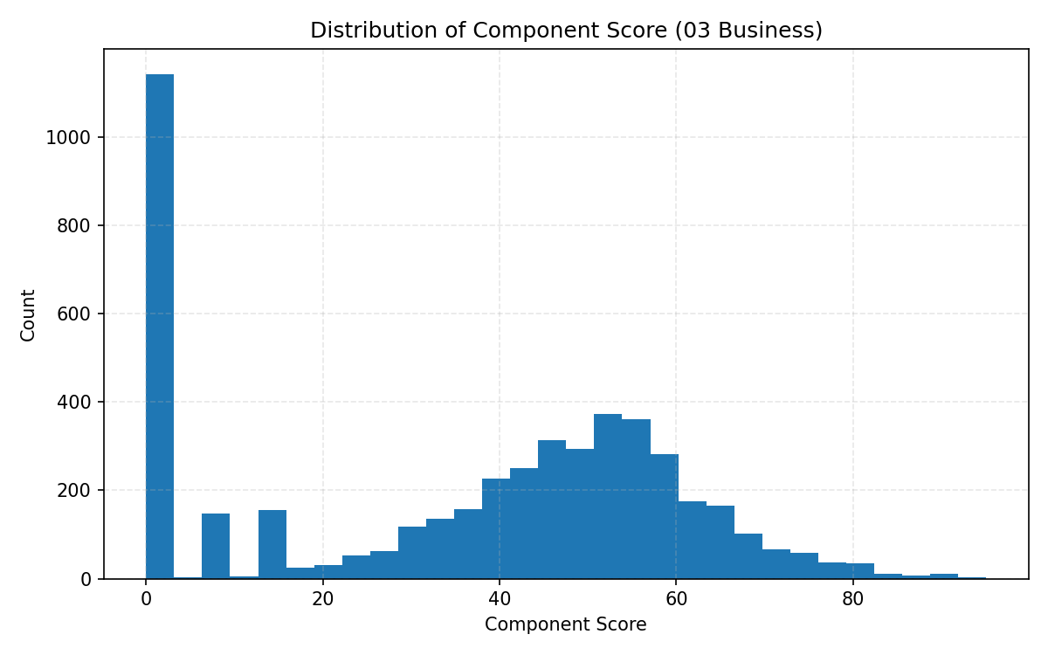
Overview
Goal
Evaluate the commercial performance of movies using budget, revenue, and production company data.
Content
Main metrics
Budget (investment level)Revenue (box office return)
Production companies (brand influence)
Key derived indicators:
ROI = log(Revenue / (Budget + 1))
Revenue score (normalized log scale)
Studio score (bonus for top studios like Disney, Warner, etc.)
Final composite score:
0.50 × ROI + 0.35 × Revenue + 0.15 × Studio→ normalized to 0–100
Notes:
This slide introduces the Business module, which evaluates the commercial success of movies based on budget, revenue, and production companies.
It explains the formula combining ROI, revenue, and studio influence into a single from 0 to 100 score.
The histogram beside it shows that most movies cluster around the middle range, with only a few achieving exceptionally high business performance.

Slide 20
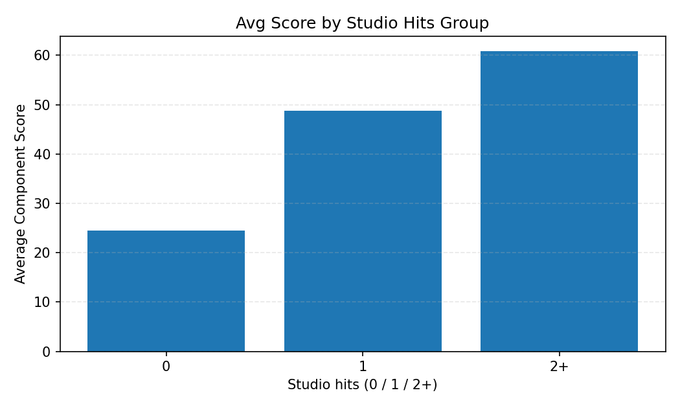
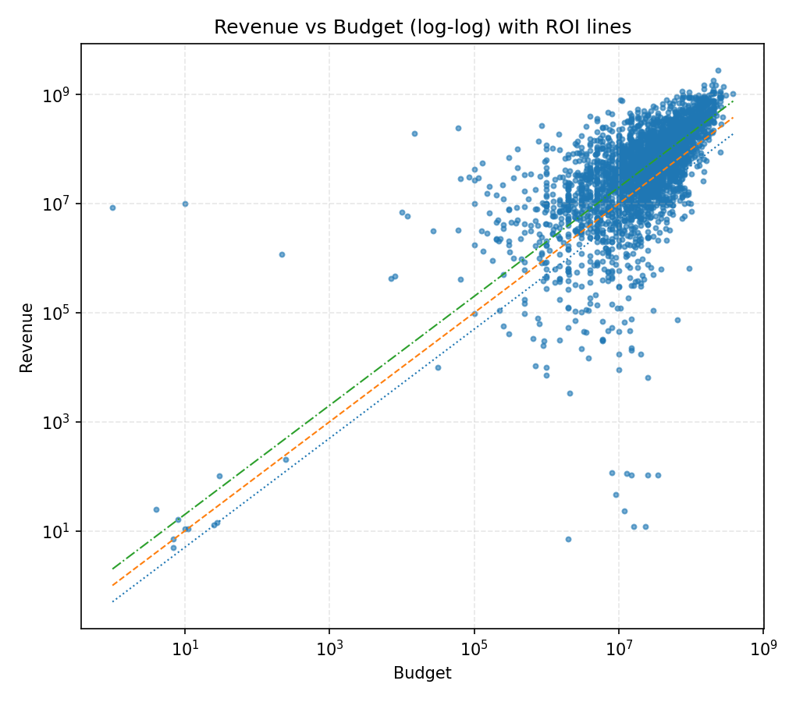
Insights from Data
1
Budget–Revenue Relationship
Positive correlation observed (log–log scale).
ROI≈1 line marks breakeven; only a small set of films surpass ROI>2.
2
Studio Effect
Movies backed by 2+ major studios show significantly higher average scores.
Confirms brand and distribution advantages.
3
ROI and Score Alignment
Component score increases consistently with ROI → formula validated.
Notes:
This page highlights the key findings.
The scatter plot (Revenue vs Budget) shows a clear positive correlation: most films lie near or below the ROI = 1 line, meaning limited profitability.
The bar chart compares average scores across different studio-involvement groups — movies backed by two or more major studios achieve the highest scores, confirming a strong studio advantage.

Slide 21
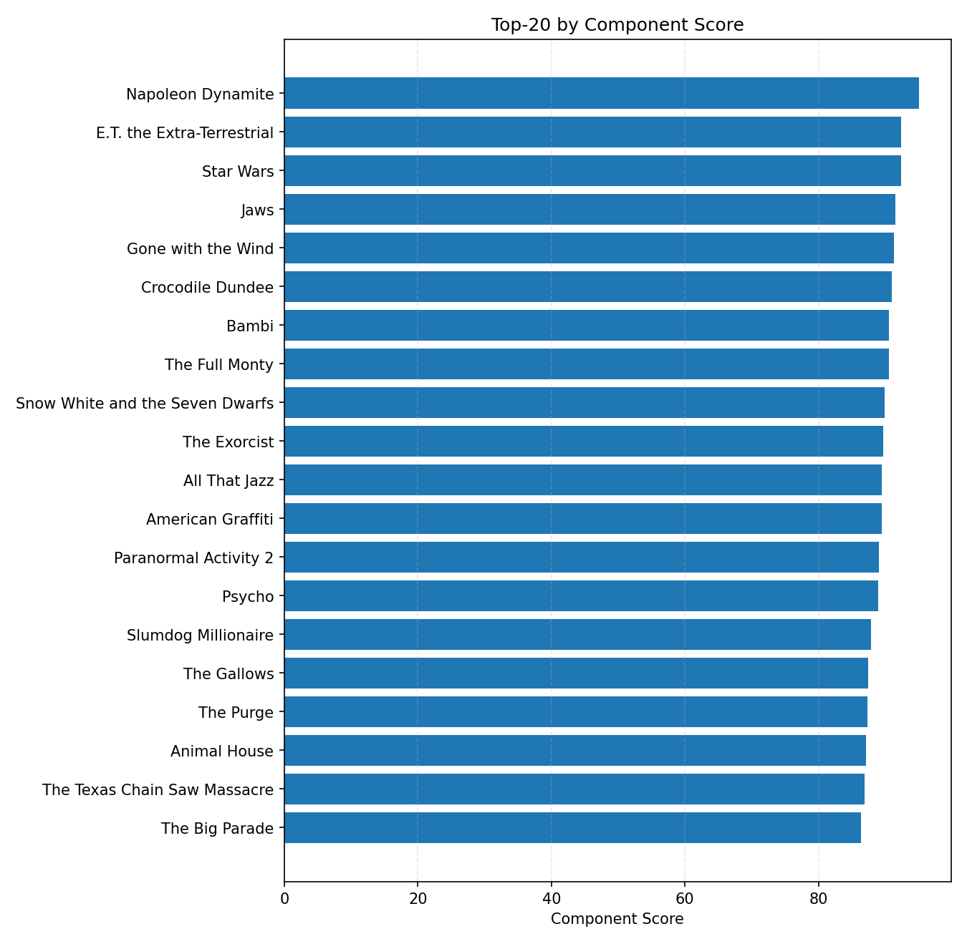
Top Performers & Conclusions
1
Top 20 films by Business Score
Mix of high-budget blockbusters and efficient mid-budget hits.
Studios like Disney, Universal, Warner Bros dominate the top ranks.
2
Key findings
High ROI can come from either strong returns or low budgets.
Studio partnerships play a measurable role in commercial success.
Scoring framework is stable and can generalize to larger datasets.
Notes:
This slide summarizes the results and lessons.
The horizontal bar chart lists the Top 20 movies ranked by Business Score — dominated by high-budget or major-studio productions.
The overall conclusion: success depends on both financial efficiency (high ROI) and brand strength from major production partners.

Slide 22
2-4 Time & Locale
elease_date、runtime、spoken_languages、original_language
By 李尚泽

Slide 23

Methodology of time & locale analysis
We performed systematic cleaning, diagnostics and scoring for the Time / Language / Locale fields in the dataset.
Concretely, this included:
normalizing release_date, heuristically normalizing runtime and flagging extreme values for manual review;
parsing spoken_languages from multiple input to extract language names or ISO codes, and providing English fallbacks to ensure labels render across machines;
standardizing original_language and computing a binary match against the target user language.
Key notes:
Runtime underwent heuristic unit normalization (>10000→ms, >500→s);
Plots exclude >500 min outliers for clarity;
Spoken_languages were parsed from JSON/dict/list and have English fallback labels.
Notes:
We cleaned, diagnosed and scored the Time / Language / Locale fields — below are the key visualizations and findings.

Slide 24
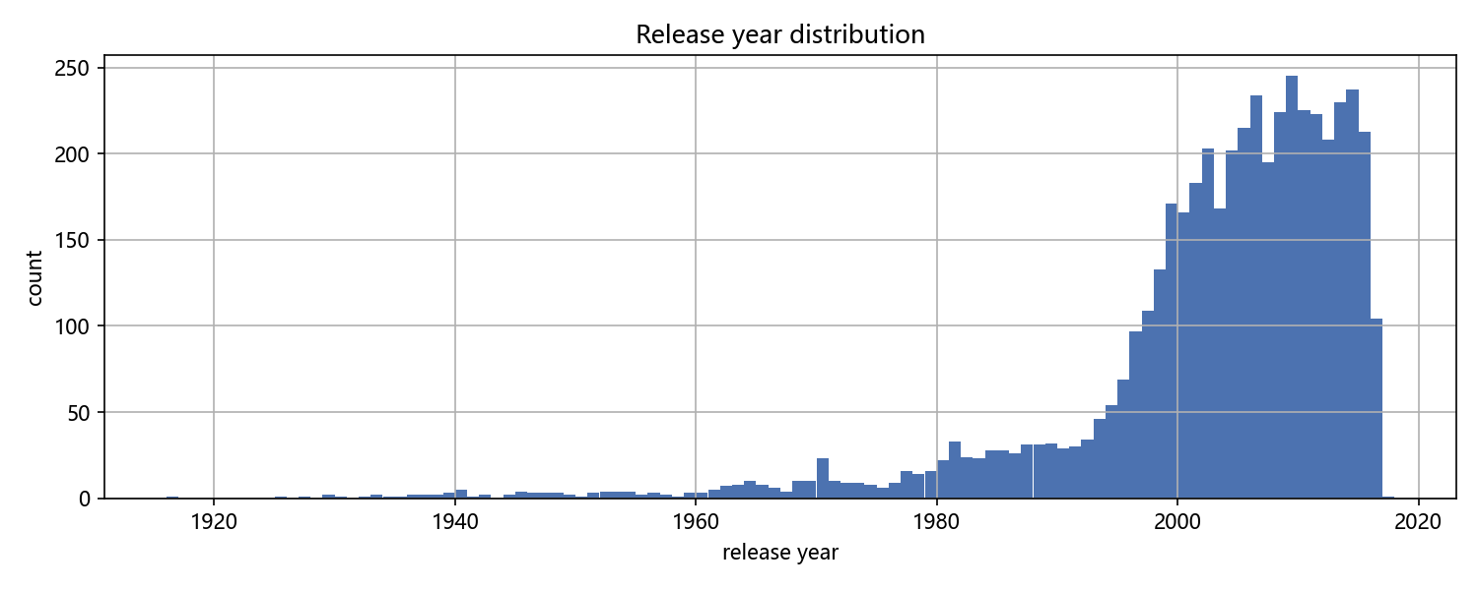
Part 1 TIME
Release year distribution
Release years concentrate in recent decades (notably post-2000), indicating the dataset skews toward newer films.
Release_year extracted from release_date;
year-only or unparsable cases are flagged in the quality table.

Slide 25
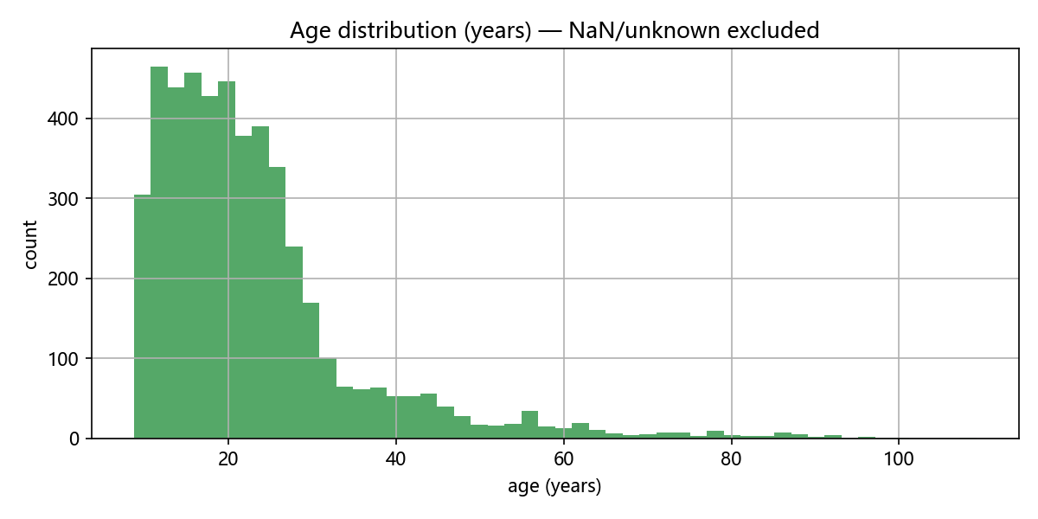
Age distribution
Age concentrates at 10–30 years, peaking around ~20; distribution is right-skewed with a long tail to older films.
Age is derived from release_date; unparsable records were excluded; recency = exp(-age / tau) with tau=2.

Slide 26
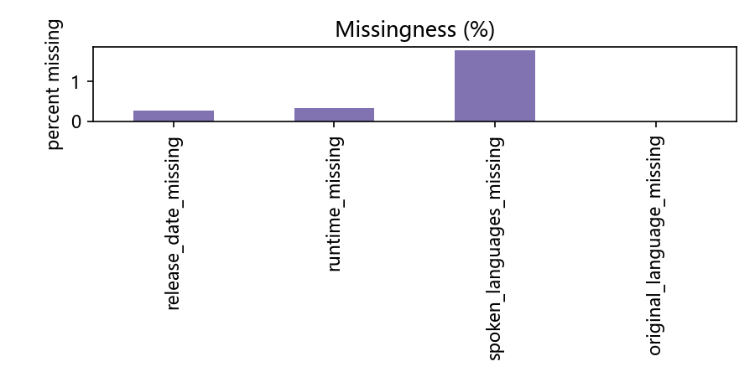
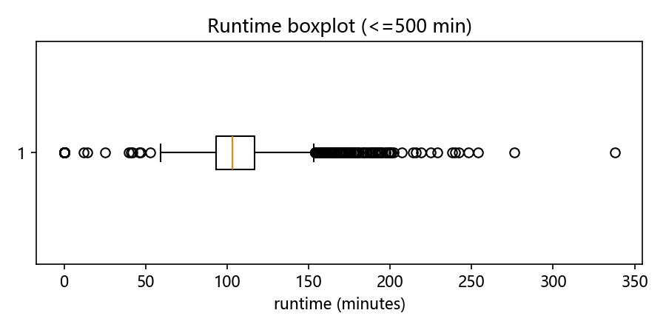
Outlier handling
Missingness across key fields is very low (spoken_languages slightly higher but ~1%); overall data quality is good for scoring and modeling.
Boxplot median ~100 min, IQR roughly ~85–140 min; some mild upper outliers exist but are within 500 min.

Slide 27
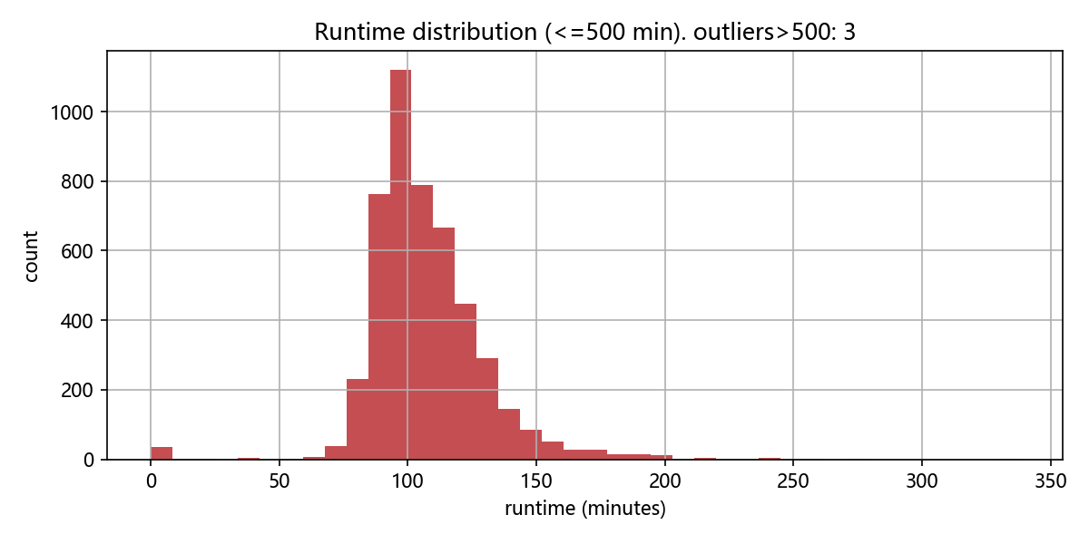
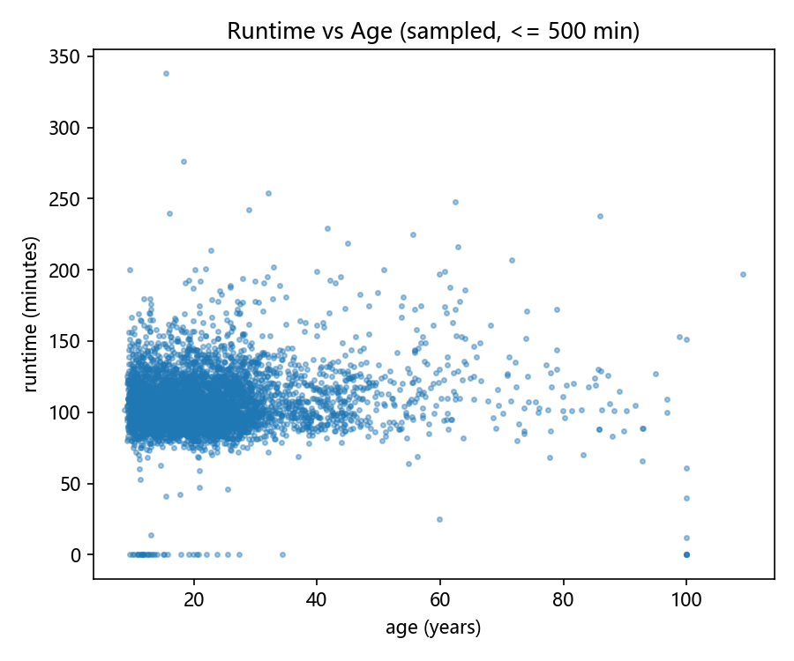
Runtime distribution
The runtime distribution demonstrates that the majority of movies fall within the typical runtime of 80-130 minutes, with a few outliers that extend far beyond 200 minutes.
This information is valuable for assessing the optimal length for movies targeted to particular audiences.
Scatter shows little trend of runtime changing with age ---- both new and old films mostly cluster around ~80-150 min.

Slide 28
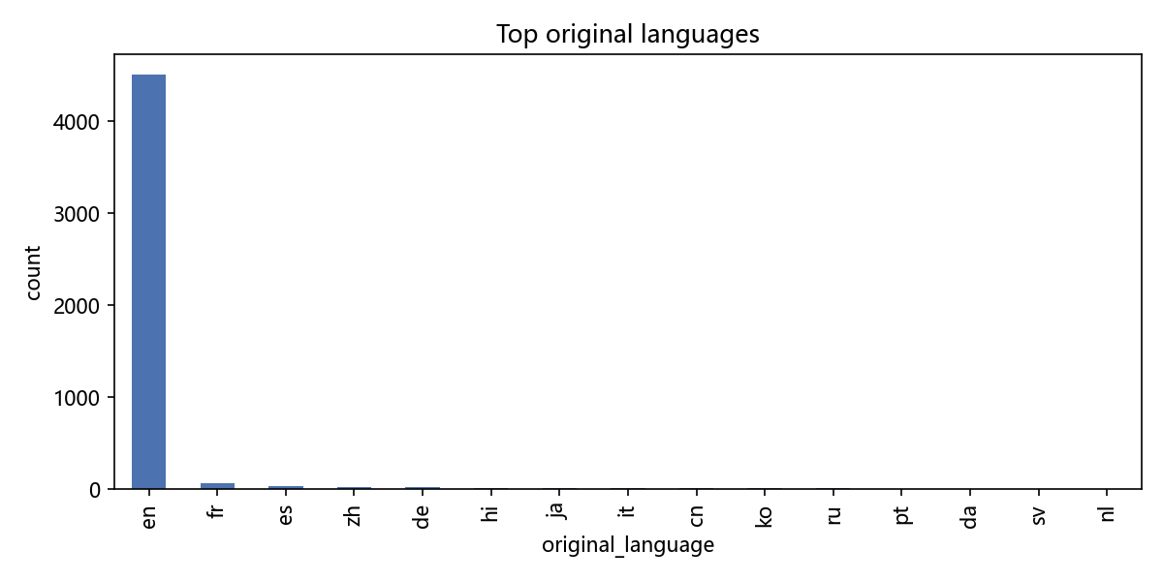
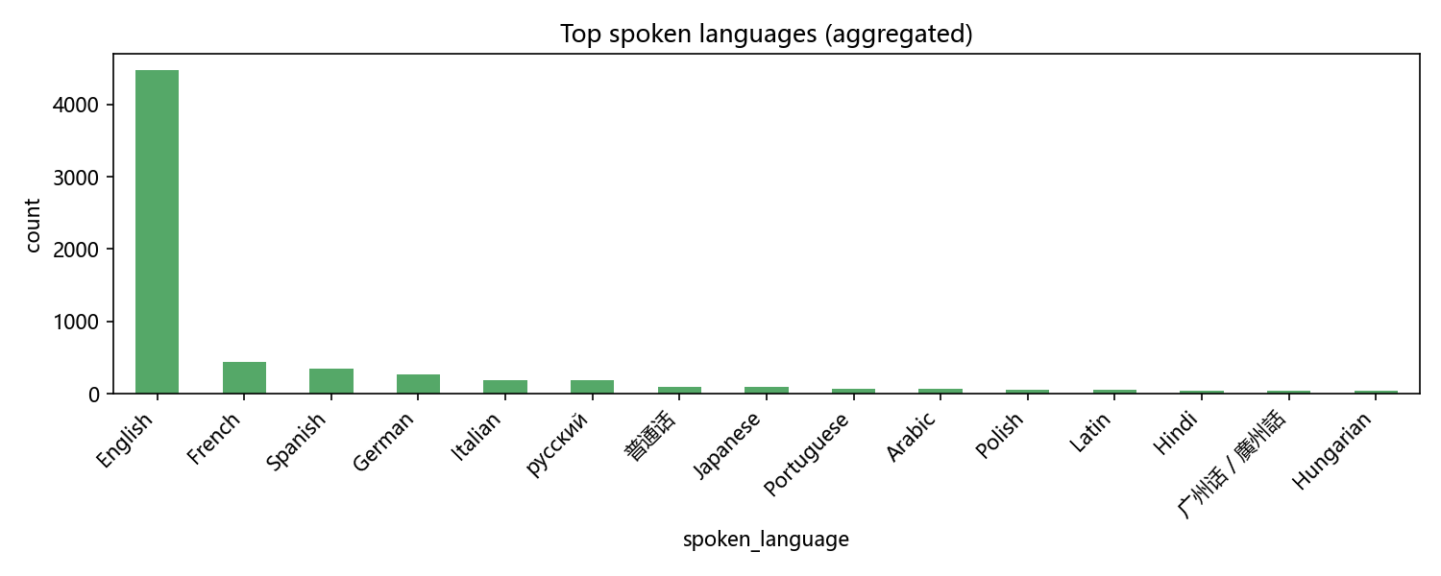
Part 2 locale
Dataset is English- and recent-film-heavy; runtimes cluster near ideal length (about 100-110 min); low missingness supports direct use of scores.
About 93.8% of samples include target language 'en' in spoken_languages or original_language — high coverage for English users.

Slide 29




Summary & recommendations
Dataset is English- and recent-film-heavy; runtimes cluster near ideal length (about 100-110 min); low missingness supports direct use of scores.
Risks & actions : Manually sample extreme runtimes (top-20) for validation; make unit-detection rules configurable; to preserve non-Latin labels across machines, include Noto fonts in project and load them at runtime.

Slide 30
Integration and Personalized Recommendation
Section 3

Slide 31
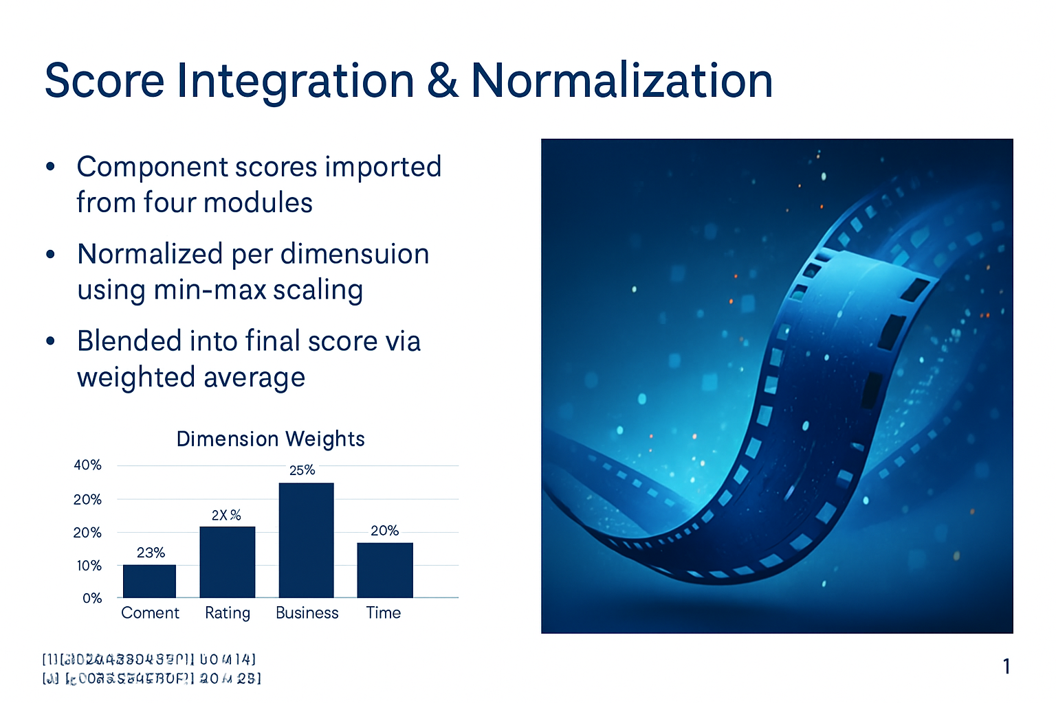
Score Integration & Normalization
Normalize per-component scores (Time, Content, Geo, Popularity, ...) and combine with configurable weights.
Support configurable weighting and normalization strategies (min-max, z-score, rank) to match product goals.
Keep intermediate feature columns and audit logs to ensure traceability and explainability.
Apply unified handling for outliers/missing values: flag in diagnostics, optional imputation or defaults.

Slide 32
Top‑N Recommendation Results
Summarize by user cohort and content buckets: English vs non-English, short vs feature, head vs long-tail.
Provide example recommendations with score breakdowns for explainability review.
Report hit-rate and user coverage (% users receiving ≥1 acceptable item).
Interpretation: A gradual drop in scores shows clear separation between top choices and the long tail, helping stakeholders focus on the most promising titles.

Slide 33
Personalized Recommendation Logic
• Age filter – under‑18 viewers avoid mature genres (Horror, Thriller, Crime, War, Mystery)
• Language preference – select your preferred original language
• Keyword search – match titles, overviews, genres and keywords
• Final score ranking – personalised filters applied on top of the global ranking
User Inputs
(Age, Language, Search)
Filter Movies
(by age, language, keywords)
Personalised List

Slide 34
Visualization & Final Deliverables
Section 4

Slide 35
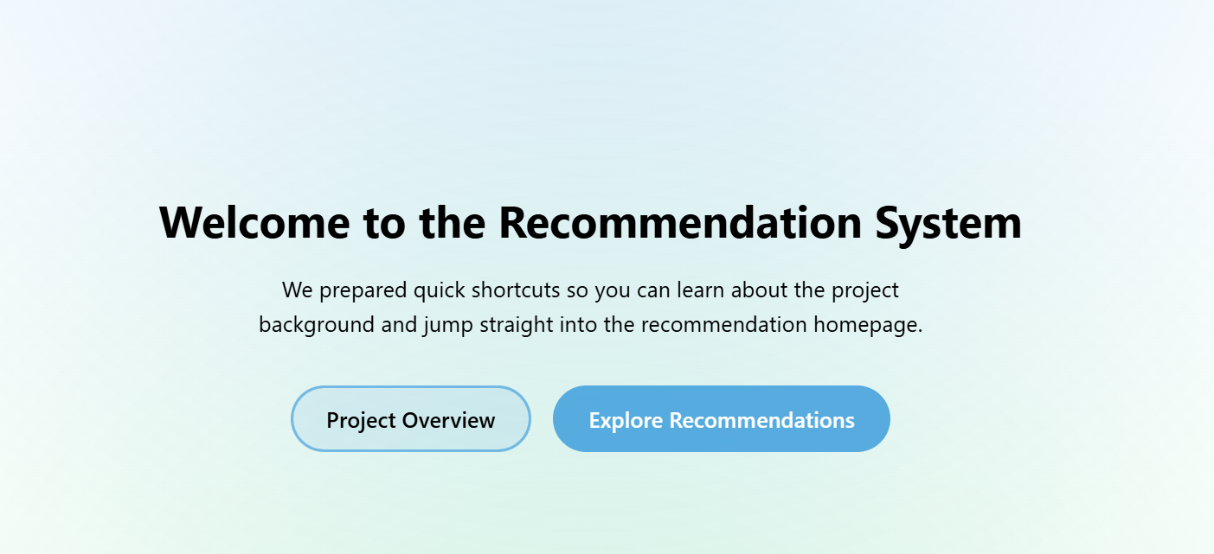
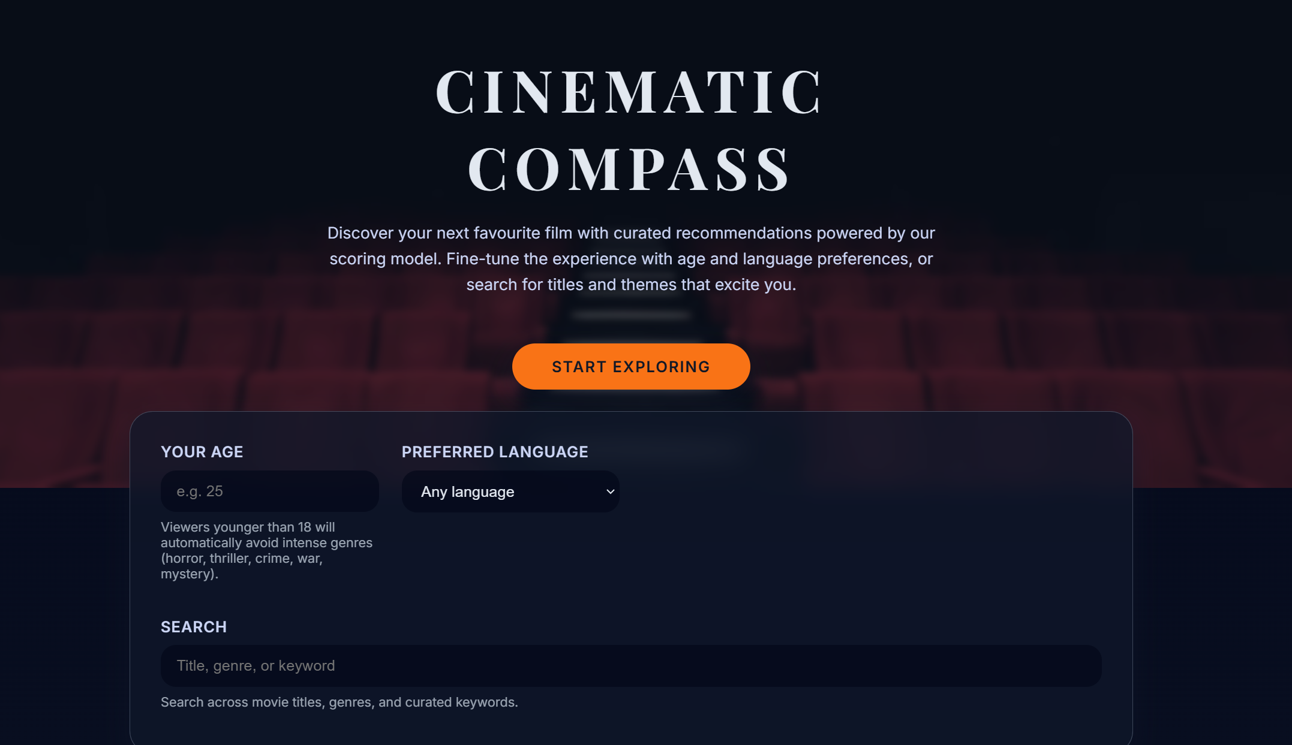
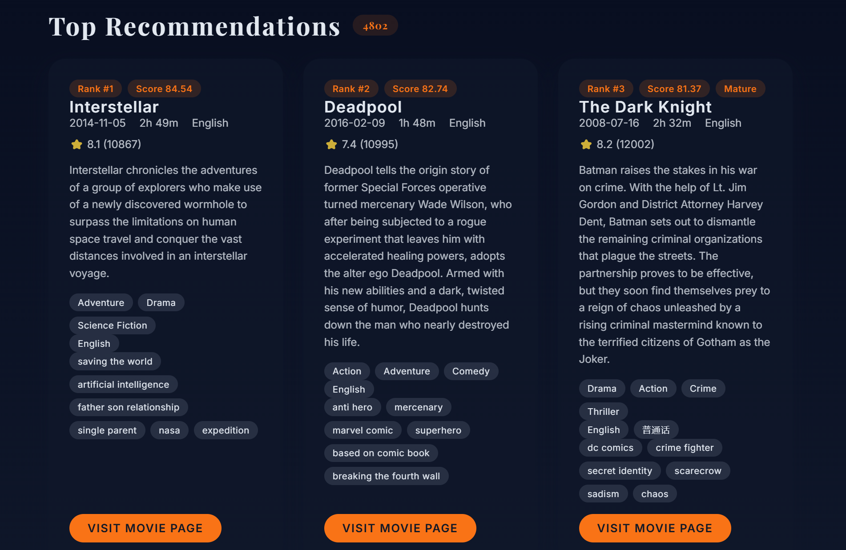
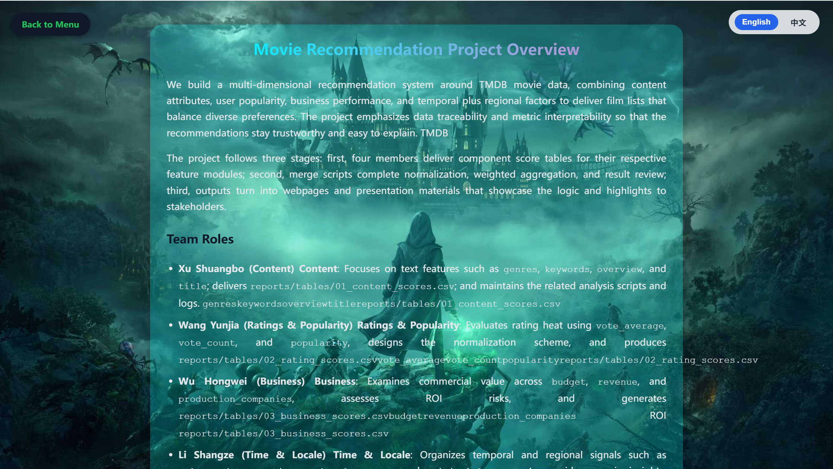
Interactive Recommendation Dashboard
• Start exploring from a welcoming hero section describing the system
• Input your age and automatically avoid restricted genres for minors
• Select preferred language and instantly filter the recommendation list
• Search across titles, genres and keywords in real time
• Top recommendations update dynamically as you interact

Slide 36
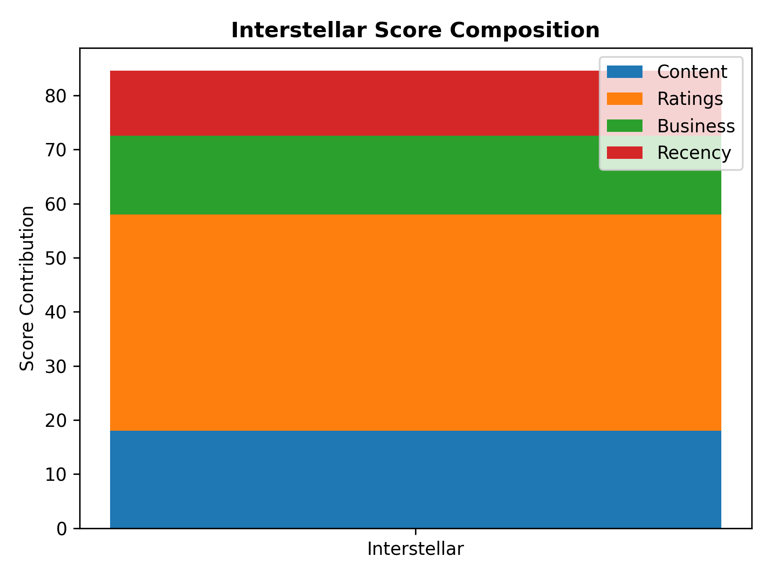
Key Visual Insights & Highlights
• Component score distributions – box plots and histograms reveal variation across content, ratings, business and time
• ROI & popularity analysis – compare budgets against returns to spot outliers and sleeper hits
• Time & locale insights – heatmaps illustrate release periods, runtimes and language preferences
• Persona comparison – different user profiles yield distinct Top 3 suggestions, highlighting the power of personalisation
• Easy to reproduce – run the Streamlit app with a single command

Slide 37
Conclusion & Future Work
Section 5

Slide 38

What we built
Developed a multi-dimensional movie recommendation system integrating four analytical modules — content, ratings, business, and temporal perspectives.
Established a unified scoring and normalization pipeline, allowing fair comparison and integration across diverse data sources.
Designed an interactive visualization dashboard to display personalized recommendations and analytical insights.
Implemented an interpretable architecture where each module’s contribution to the final recommendation is transparent and adjustable.

Slide 39

Reflections—What we learned
Learned the importance of data consistency and normalization when merging heterogeneous datasets (textual, numerical, and temporal).
Recognized how balancing popularity and quality metrics enhances fairness and recommendation diversity.
Improved teamwork through modular development and peer-reviewed GitHub workflows, ensuring reproducibility and version control.
Enhanced our understanding of user-centric design, where personalization and interpretability must coexist.

Slide 40

Outlook—What’s next
Integrate deep learning models (e.g., embeddings or neural collaborative filtering) to improve accuracy and contextual understanding.
Expand the dataset to include user demographic and behavioral data for richer personalization.
Deploy the system as a web service or mobile app with real-time recommendation updates.
Conduct A/B testing to evaluate performance and gather feedback from real users.
Explore cross-domain recommendations (e.g., linking movies with books, games, or TV shows) to enhance the user experience.

Slide 41
Thanks
Team: group2
View our website: https://shuangboxu.github.io/python-project/index.html
View our group’s introduction:
https://shuangboxu.github.io/python-project/intro/about.html

